Slide 1
ONLINE TICKET BOOKING AND FEEDBACK SERVICES
By
Abhinav Suman(2020kucp1052@iiitkota.ac.in)

Slide 2
ABOUT
An event booking website where user can select a show and book tickets .
In the feedback section user needs to put his name and rate the Event( In terms of the organizer) .

Slide 3




.
PYTHON
POSTGRES
MAILTRAP
We use python to develop this app web application.
We use postgres to store the feedback data in the database.
after submitting the feedback form customer will receive an email .
we use html & css to create our web application UI .

Slide 4

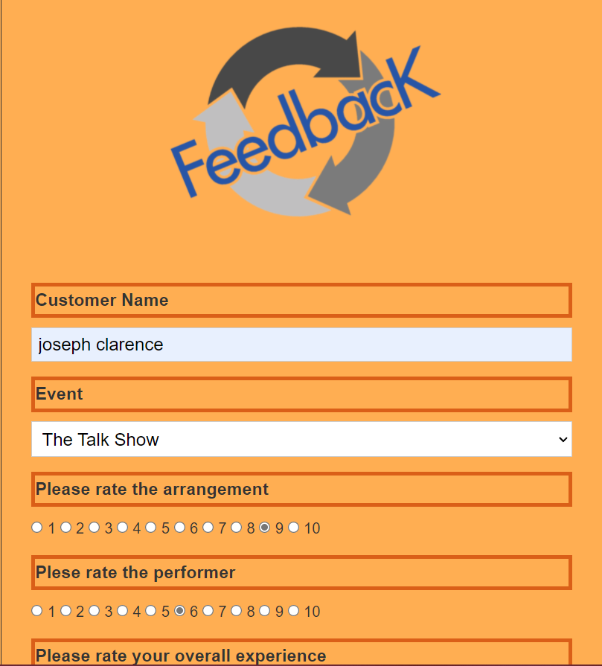
FEEDBACK FORM

Slide 5
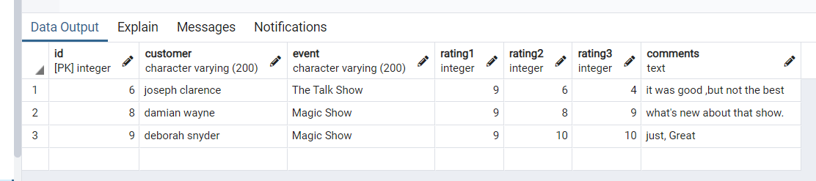
FEEDBACK DATA IN POSTGRES

Slide 6
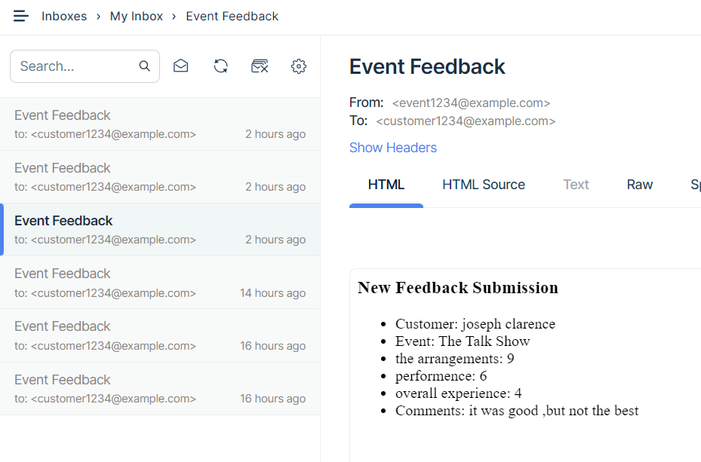
EMAIL ON MAILTRAP

Slide 7
THANK YOU

